Slide 1
CSS

Slide 2
Introduction to CSS
CSS stands for Cascading Style Sheets
CSS describes how HTML elements are to be displayed on screen, paper, or in other media
CSS saves a lot of work. It can control the layout of multiple web pages all at once
External stylesheets are stored in CSS files

Slide 3
CSS stands for Cascading Style Sheets.
CSS describes how HTML elements are to be displayed on screen, paper, or in other media.
CSS saves a lot of work. It can control the layout of multiple web pages all at once.
CSS can be added to HTML elements in 3 ways:
Inline - by using the style attribute in HTML elements
Internal - by using a <style> element in the <head> section
External - by using an external CSS file

Slide 4
Inline CSS
An inline CSS is used to apply a unique style to a single HTML element.
An inline CSS uses the style attribute of an HTML element.
This example sets the text color of the <h1> element to blue:
<h1 style="color:blue;">This is a Blue Heading</h1>

Slide 5
Example
body {
background-color: lightblue;
}
h1 {
color: white;
text-align: center;
}
p {
font-family: verdana;
font-size: 20px;
}
Try it Yourse

Slide 6
Internal CSS
An internal CSS is used to define a style for a single HTML page.
An internal CSS is defined in the <head> section of an HTML page, within a <style> element:
<!DOCTYPE html>
<html>
<head>
<style>
body {background-color: powderblue;}
h1 {color: blue;}
p {color: red;}
</style>
</head>
<body>
<h1>This is a heading</h1>
<p>This is a paragraph.</p>
</body>
</html>

Slide 7
External CSS
An external style sheet is used to define the style for many HTML pages.
With an external style sheet, you can change the look of an entire web site, by changing one file!
To use an external style sheet, add a link to it in the <head> section of the HTML page:
<!DOCTYPE html>
<html>
<head>
<link rel="stylesheet" href="styles.css">
</head>
<body>
<h1>This is a heading</h1>
<p>This is a paragraph.</p>
</body>
</html>

Slide 8
An external style sheet can be written in any text editor. The file must not
contain any HTML code, and must be saved with a .css extension.
Here is how the "styles.css" looks:
body {
background-color: powderblue;
}
h1 {
color: blue;
}
p {
color: red;
}
HTML Links - Syntax
In HTML, links are defined with the <a> tag:
<a href="url">link text</a>
The href attribute specifies the destination address of the link. The link text is the visible part (Visit our HTML tutorial).

Slide 9
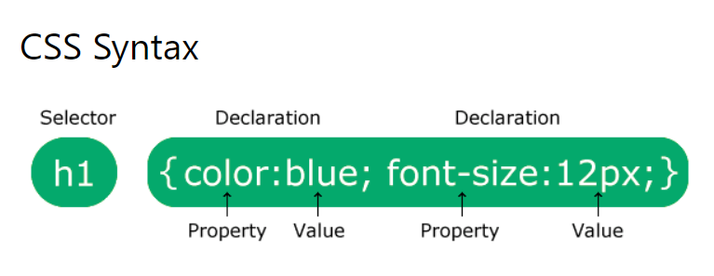
CSS

Slide 10
CSS
The selector points to the HTML element you want to style.
The declaration block contains one or more declarations separated by semicolons.
Each declaration includes a CSS property name and a value, separated by a colon.
Multiple CSS declarations are separated with semicolons, and declaration blocks are surrounded by curly braces.

Slide 11
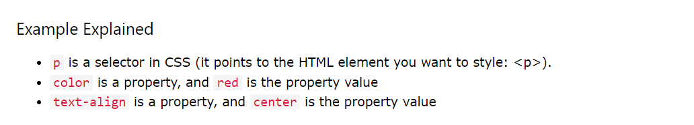
p {
color: red;
text-align: center;
}

Slide 12
● External style sheet
With an external style sheet, you can change the look of an entire website by changing just one file!
Each HTML page must include a reference to the external style sheet file inside the <link> element, inside the head section.

Slide 13
Example
<!DOCTYPE html>
<html>
<head>
<link rel="stylesheet" href="mystyle.css">
</head>
<body>
<h1>This is a heading</h1>
<p>This is a paragraph.</p>
</body>
</html>

Slide 14
CSS
body {
background-color: lightblue;
}
h1 {
color: navy;
margin-left: 20px;
}

Slide 15
Internal CSS
<!DOCTYPE html>
<html>
<head>
<style>
body {
background-color: linen;
}
h1 {
color: maroon;
margin-left: 40px;
}
</style>
</head>
<body>
<h1>This is a heading</h1>
<p>This is a paragraph.</p>
</body>
</html>

Slide 16
Inline CSS
An inline style may be used to apply a unique style for a single element.
To use inline styles, add the style attribute to the relevant element. The style attribute can contain any CSS property.

Slide 17
Example
<!DOCTYPE html>
<html>
<body>
<h1 style="color:blue;text-align:center;">This is a heading</h1>
<p style="color:red;">This is a paragraph.</p>
</body>
</html>

Slide 18
Font Properties
p.a {
font: 15px Arial, sans-serif;
}
p.b {
font: italic small-caps bold 12px/30px Georgia, serif;
}

Slide 19
p.a {
font-style: normal;
}
p.b {
font-style: italic;
}
p.c {
font-style: oblique;
}

Slide 20
p.small {
font-variant: small-caps;
}
font-variant: normal|small-caps|initial|inherit;

Slide 21
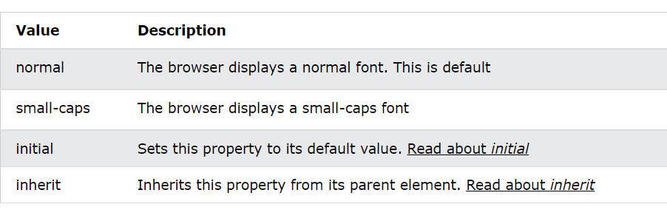

Slide 22
p.normal {
font-weight: normal;
}
p.thick {
font-weight: bold;
}
p.thicker {
font-weight: 900;
}

Slide 23
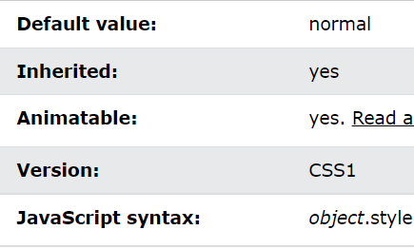

Slide 24
CSS line-height Property
div.a {
line-height: normal;
}
div.b {
line-height: 1.6;
}
div.c {
line-height: 80%;
}
div.d {
line-height: 200%;
}

Slide 25
p.a {
font-family: "Times New Roman", Times, serif;
}
p.b {
font-family: Arial, Helvetica, sans-serif;
}

Slide 26
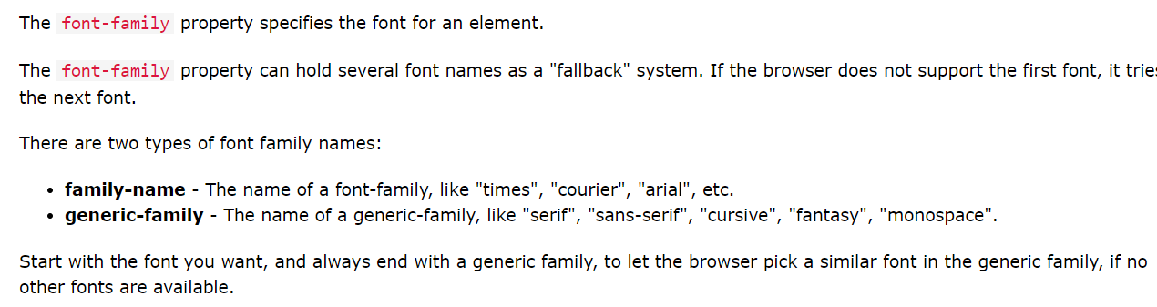
Definition and Usage

Slide 27
CSS Comments
Comments are used to explain the code, and may help when you edit the source code at a later date.
p {
color: red;
}

Slide 28
p {
color: red; /* Set text color to red */
}

Slide 29
<!DOCTYPE html>
<html>
<head>
<style>
p {
color: red; /* Set text color to red */
}
</style>
</head>
<body>
<h2>My Heading</h2>
<!-- These paragraphs will be red -->
<p>Hello World!</p>
<p>This paragraph is styled with CSS.</p>
<p>CSS comments are not shown in the output.</p>
</body>
</html>

Slide 30
The CSS Box Model
In CSS, the term "box model" is used when talking about design and layout.
The CSS box model is essentially a box that wraps around every HTML element. It consists of: margins, borders, padding, and the actual content. The image below illustrates the box model:

Slide 31
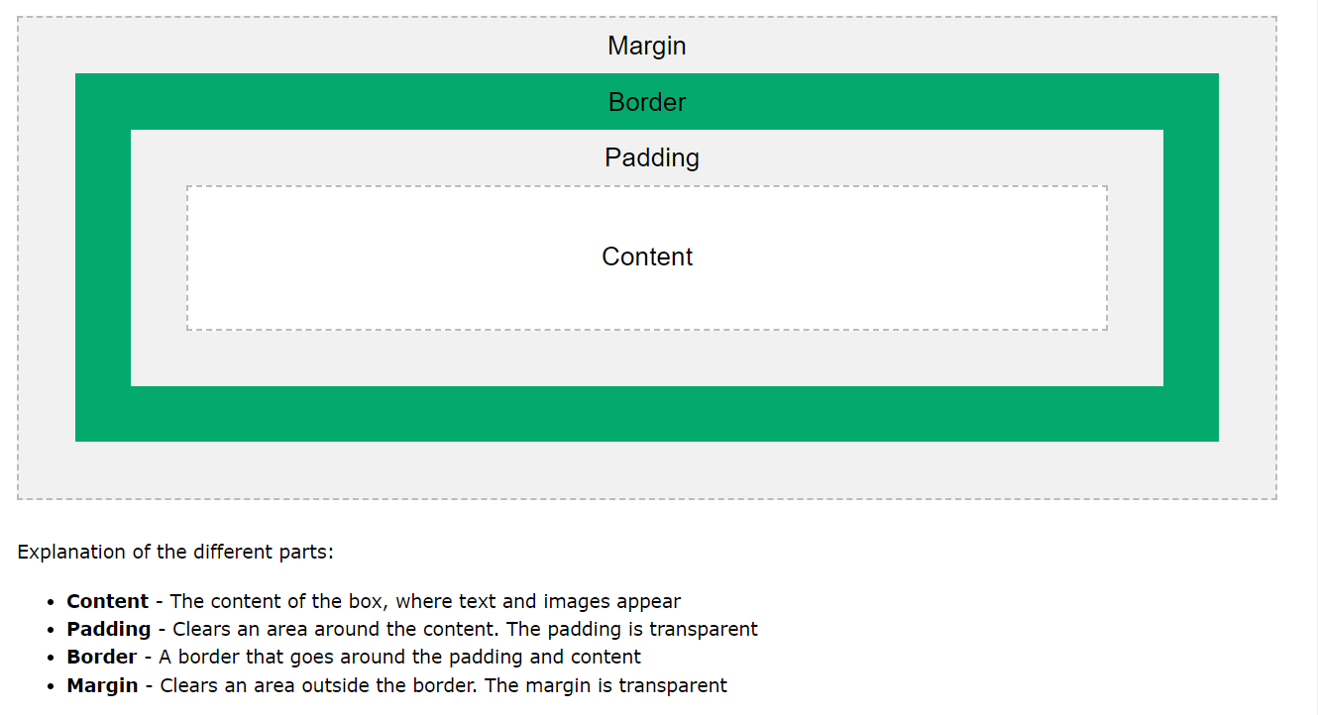

Slide 32
div {
width: 300px;
border: 15px solid green;
padding: 50px;
margin: 20px;
}

Slide 33
Both the tags (<div> and <span>) are used to represent the part of the webpgage, <div> tag is used a as block part of the webpage and <span> tag is used as a inline part of the webpage.
HTML <div> tag: The div tag is known as Division tag. The div tag is used in HTML to make divisions of content on the web page like (text, images, header, footer, navigation bar, etc). Div tag has both opening(<div>) and closing (</div>) tags and it is mandatory to close the tag.

Slide 34
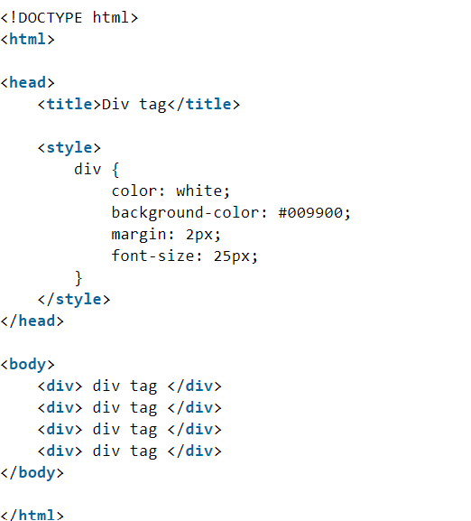

Slide 35
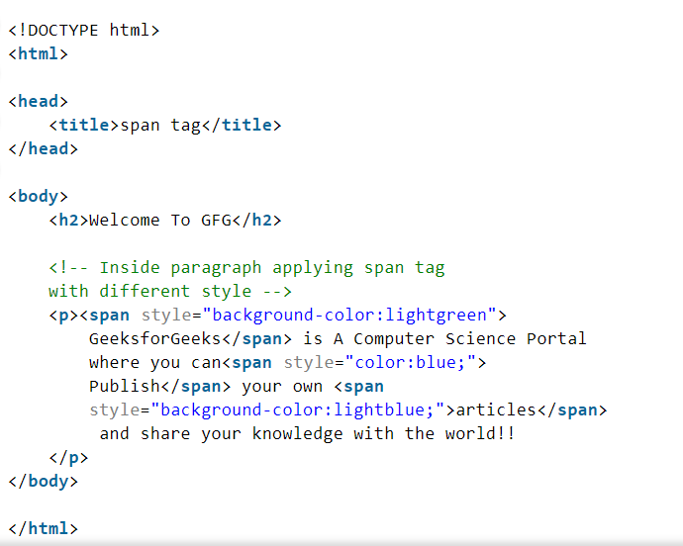

Slide 36
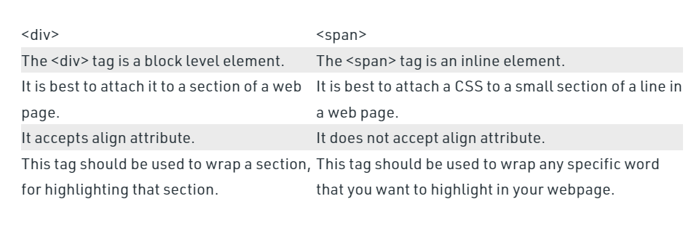

Slide 37
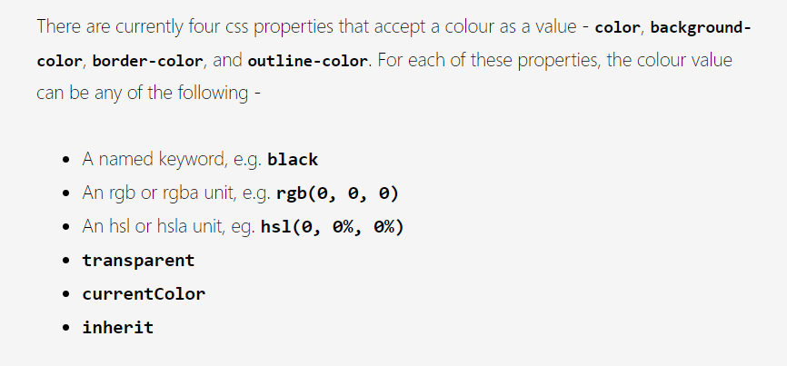
Working with colors

Slide 38
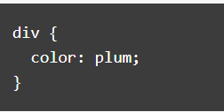
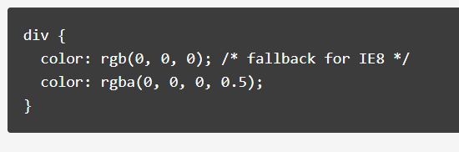
Example

Slide 39
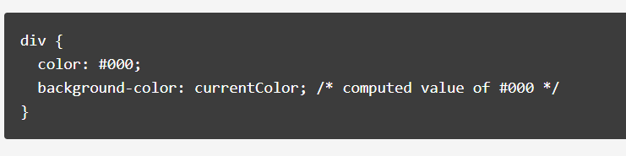

Slide 40
Colors in css
inherit
This value specifies that the element should take the same colour as it's parent.

Slide 41
HSL Functional Notation
The hue value (H) is specified by the supported angle unit in CSS. It includes deg, rad, grad, and turn. Saturation (S) specifies the percentage of the final color made up of hue. The luminosity (L) component defines the grey level.
/*Syntax*/
color: hsl(XXdeg, XX%, XX%);
color: hsl(XXturn, XX%, XX%);

Slide 42
Set a background-image for the <body> element:
body {
background-image: url("paper.gif");
background-color: #cccccc;
}
Setting 2 background image
body {
background-image: url("img_tree.gif"), url("paper.gif");
background-color: #cccccc;
}

Slide 44
Syntax
background-image: url|none|initial|inherit;
body {
background-image: url("img_tree.gif"), url("paper.gif");
background-repeat: no-repeat, repeat;
background-color: #cccccc;
}

Slide 45
Use different background properties to create a "hero" image:
.hero-image {
background-image: url("photographer.jpg"); /* The image used */
background-color: #cccccc; /* Used if the image is unavailable */
height: 500px; /* You must set a specified height */
background-position: center; /* Center the image */
background-repeat: no-repeat; /* Do not repeat the image */
background-size: cover; /* Resize the background image to cover the entire container */
}

Slide 46
Sets a linear-gradient (two colors) as a background image for a <div> element:
#grad1 {
height: 200px;
background-color: #cccccc;
background-image: linear-gradient(red, yellow);
}

Slide 47
Let the background-image start from the upper left corner of the content:
#example1 {
border: 10px dashed black;
padding: 25px;
background: url(paper.gif);
background-repeat: no-repeat;
background-origin: content-box;
}

Slide 48
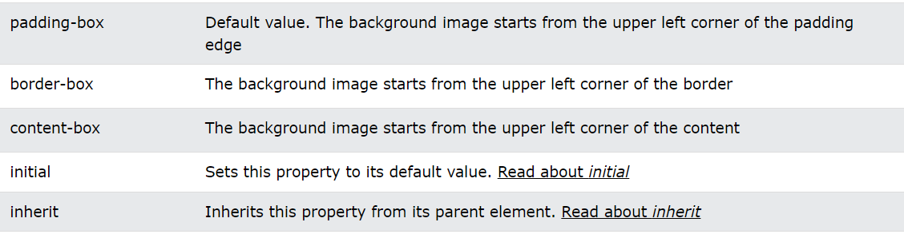
Css - Background
background-origin: padding-box|border-box|content-box|initial|inherit;

Slide 49
How to position a background-image:
body {
background-image: url('w3css.gif');
background-repeat: no-repeat;
background-attachment: fixed;
background-position: center;
}

Slide 50
Syntax
background-position: value;
body {
background-image: url('w3css.gif');
background-repeat: no-repeat;
background-attachment: fixed;
background-position: center top;
}

Slide 51
How to position a background-image using pixels:
body {
background-image: url('w3css.gif');
background-repeat: no-repeat;
background-attachment: fixed;
background-position: 50px 150px;
}

Slide 52
Classes
Select and style all elements with class="intro":
.intro {
background-color: yellow;
}

Slide 53
Definition

Slide 54
CSS Syntax
.class {
css declarations;
}

Slide 55
Style all <p> elements with class="hometown":
p.hometown {
background-color: yellow;
}
This <p> element will be styled according to class="center" AND to class="large":
<p class="center large">This paragraph refers to two classes.</p>

Slide 56
CSS #id Selector
Style the element with id="firstname":
#firstname {
background-color: yellow;
}

Slide 57
CSS Syntax
#id {
css declarations;
}

Slide 58
CSS * Selector
Select all elements, and set their background color to yellow:
* {
background-color: yellow;
}

Slide 59
Select all elements inside <div> elements and set their background color to yellow:
div * {
background-color: yellow;
}

Slide 60
Select and style every <p> element that is inside <div> elements:
div p {
background-color: yellow;
}

Slide 61
What are Pseudo-Elements?
A CSS pseudo-element is used to style specified parts of an element.
For example, it can be used to:
Style the first letter, or line, of an element
Insert content before, or after, the content of an element

Slide 62
selector::pseudo-element {
property: value;
}

Slide 63
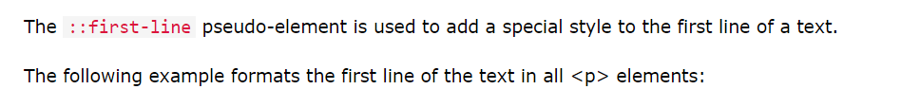
The ::first-line Pseudo-element
p::first-line {
color: #ff0000;
font-variant: small-caps;
}

Slide 64
The following properties apply to the ::first-line pseudo-element:
font properties
color properties
background properties
word-spacing
letter-spacing
text-decoration
vertical-align
text-transform
line-height
clear

Slide 65
Multiple Pseudo-elements
p::first-letter {
color: #ff0000;
font-size: xx-large;
}
p::first-line {
color: #0000ff;
font-variant: small-caps;
}

Slide 66
CSS - The ::selection Pseudo-element
::selection {
color: red;
background: yellow;
}

Slide 67
Styling Links
Style can be done on any CSS properties
a {
color: hotpink;
}

Slide 68
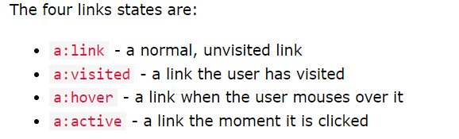

Slide 69
/* unvisited link */
a:link {
color: red;
}
/* visited link */
a:visited {
color: green;
}
/* mouse over link */
a:hover {
color: hotpink;
}
/* selected link */
a:active {
color: blue;
}

Slide 70
Text Decoration
To remove the underline from the link.
a:link {
text-decoration: none;
}
a:visited {
text-decoration: none;
}
a:hover {
text-decoration: underline;
}
a:active {
text-decoration: underline;
}

Slide 71
Background Color
property can be used to specify a background color for links:
a:link {
background-color: yellow;
}
a:visited {
background-color: cyan;
}
a:hover {
background-color: lightgreen;
}
a:active {
background-color: hotpink;
}

Slide 72
Link Buttons
a:link, a:visited {
background-color: #f44336;
color: white;
padding: 14px 25px;
text-align: center;
text-decoration: none;
display: inline-block;
}
a:hover, a:active {
background-color: red;
}

Slide 73
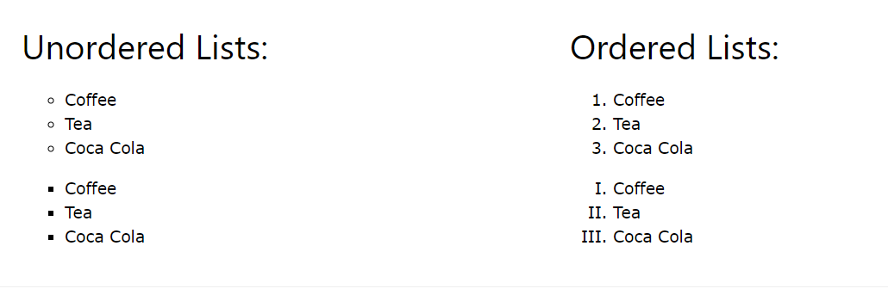
Styling Lists

Slide 74
Different List Item Markers
ul.a {
list-style-type: circle;
}
ul.b {
list-style-type: square;
}
ol.c {
list-style-type: upper-roman;
}
ol.d {
list-style-type: lower-alpha;
}

Slide 75
An Image as The List Item Marker
ul {
list-style-image: url('sqpurple.gif');
}

Slide 76
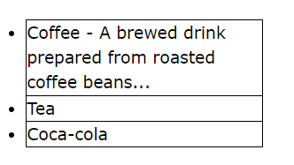
Position The List Item Markers
"list-style-position: outside;" means that the bullet points will be outside the list item. The start of each line of a list item will be aligned vertically. This is default:

Slide 77
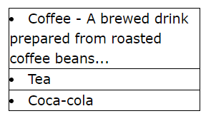
"list-style-position: inside;" means that the bullet points will be inside the list item. As it is part of the list item, it will be part of the text and push the text at the start:

Slide 78
example
ul.a {
list-style-position: outside;
}
ul.b {
list-style-position: inside;
}

Slide 79
Remove Default Settings
ul {
list-style-type: none;
margin: 0;
padding: 0;
}

Slide 80
List - Shorthand property
ul {
list-style: square inside url("sqpurple.gif");
}

Slide 81
Styling List With Colors
ol {
background: #ff9999;
padding: 20px;
}
ul {
background: #3399ff;
padding: 20px;
}
ol li {
background: #ffe5e5;
color: darkred;
padding: 5px;
margin-left: 35px;
}
ul li {
background: #cce5ff;
color: darkblue;
margin: 5px;
}

Slide 82
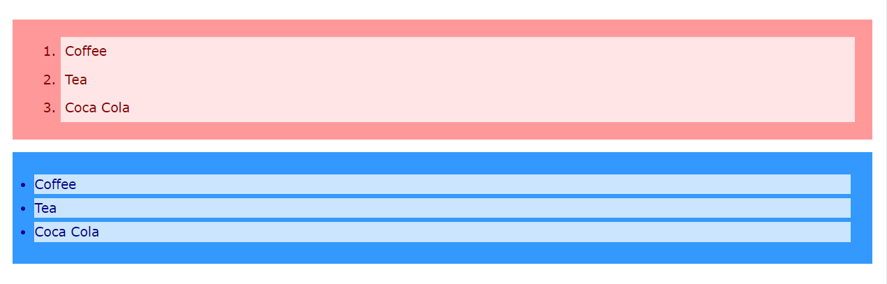
Output

Slide 83
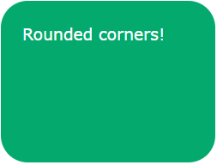
Rounded Corners
property defines the radius of an element's corners.
1. Rounded corners for an element with a specified background color:

Slide 84
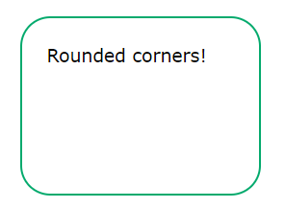
2. Rounded corners for an element with a border:

Slide 85
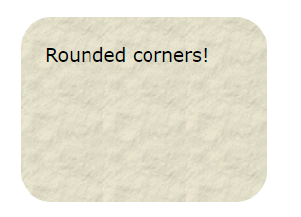
Rounded corners for an element with a background image:

Slide 86
Example
#rcorners1 {
border-radius: 25px;
background: #73AD21;
padding: 20px;
width: 200px;
height: 150px;
}
#rcorners2 {
border-radius: 25px;
border: 2px solid #73AD21;
padding: 20px;
width: 200px;
height: 150px;
}
#rcorners3 {
border-radius: 25px;
background: url(paper.gif);
background-position: left top;
background-repeat: repeat;
padding: 20px;
width: 200px;
height: 150px;
}

Slide 87
CSS border-radius - Specify Each Corner
property can have from one to four values. Here are the rules:
Four values - border-radius: 15px 50px 30px 5px; (first value applies to top-left corner, second value applies to top-right corner, third value applies to bottom-right corner, and fourth value applies to bottom-left corner):

Slide 88


Slide 89

Three values - border-radius: 15px 50px 30px; (first value applies to top-left corner, second value applies to top-right and bottom-left corners, and third value applies to bottom-right corner):

Slide 90
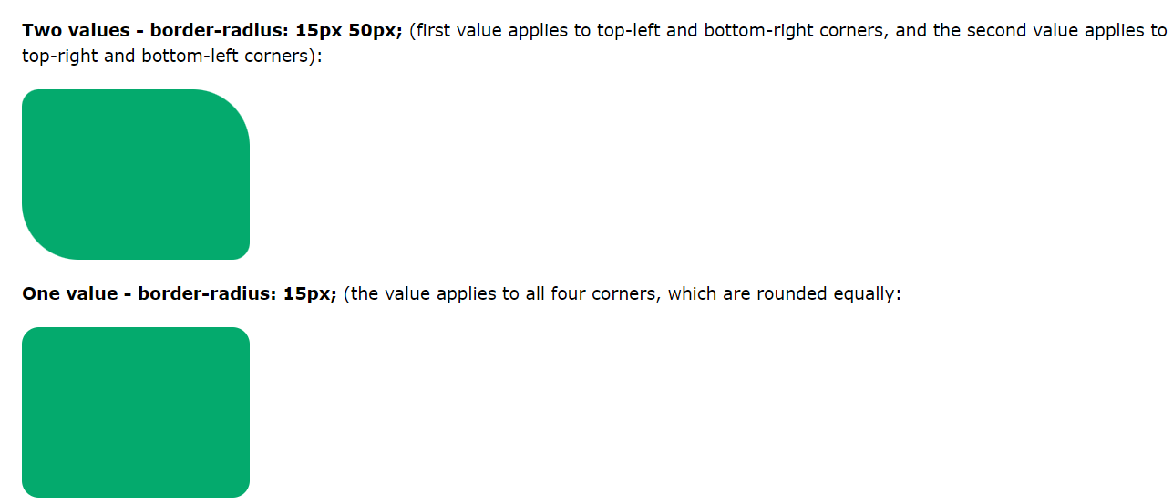
Rounded

Slide 91
Example
#rcorners1 {
border-radius: 15px 50px 30px 5px;
background: #73AD21;
padding: 20px;
width: 200px;
height: 150px;
}
#rcorners2 {
border-radius: 15px 50px 30px;
background: #73AD21;
padding: 20px;
width: 200px;
height: 150px;
}

Slide 92
continue
#rcorners3 {
border-radius: 15px 50px;
background: #73AD21;
padding: 20px;
width: 200px;
height: 150px;
}
#rcorners4 {
border-radius: 15px;
background: #73AD21;
padding: 20px;
width: 200px;
height: 150px;
}

Slide 93
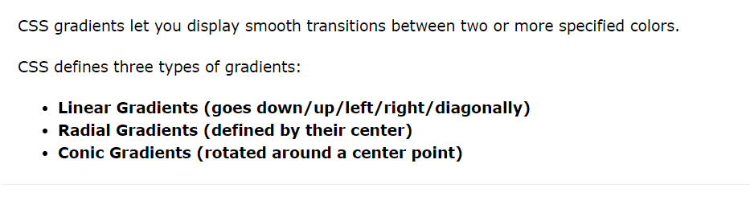
Linear Gradient

Slide 94
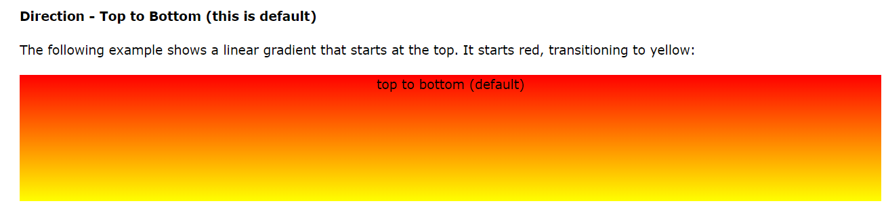
CSS Linear Gradients
background-image: linear-gradient(direction, color-stop1, color-stop2, ...);

Slide 95
example
#grad {
background-image: linear-gradient(red, yellow);
}

Slide 96
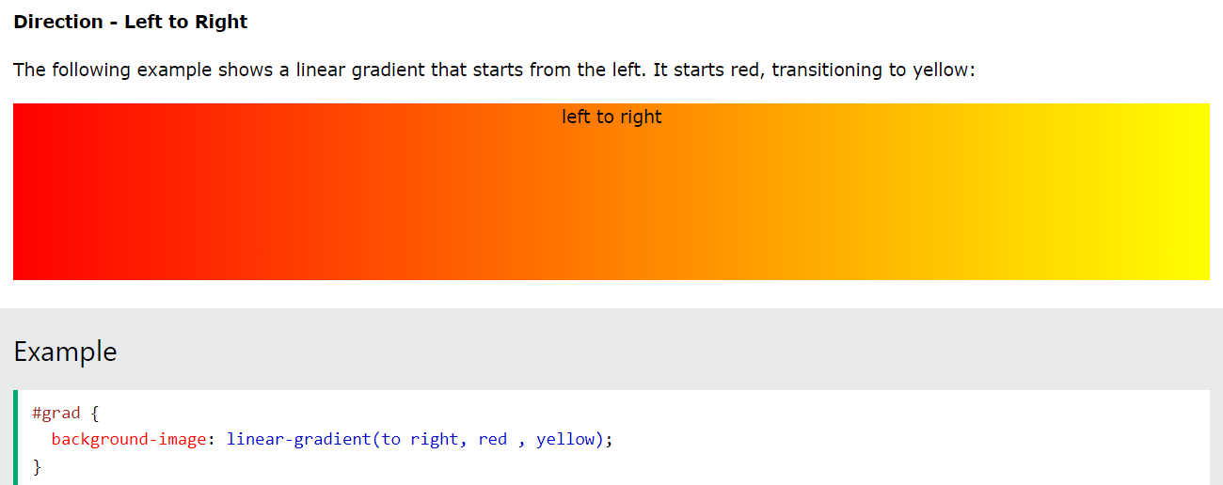

Slide 97
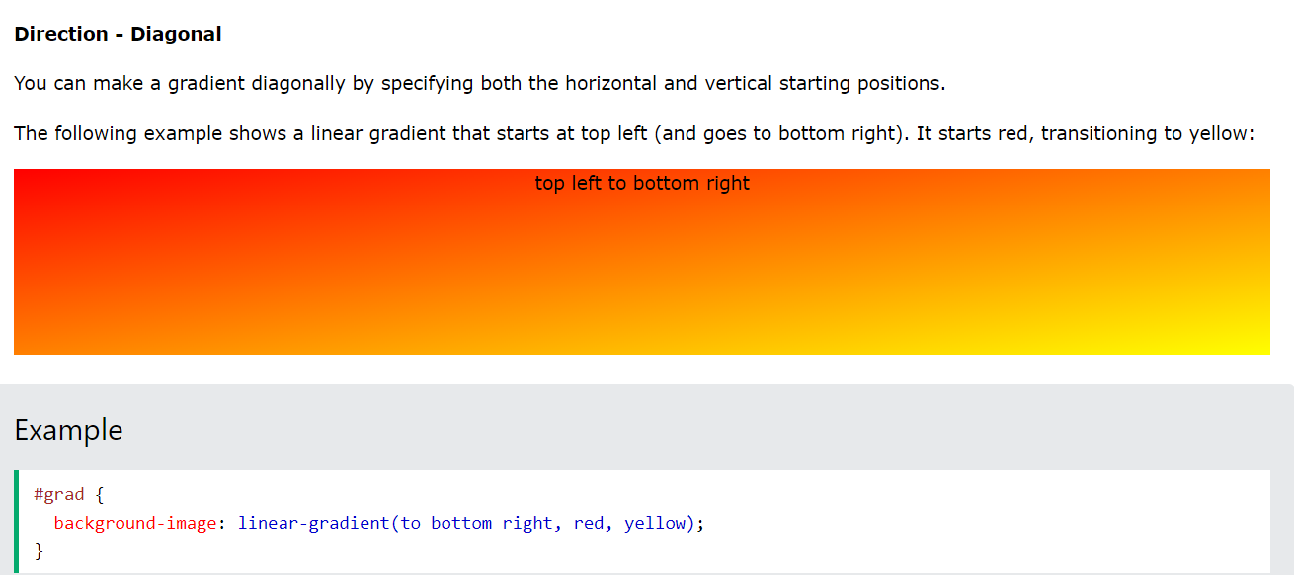

Slide 98
Using Angles
If you want more control over the direction of the gradient, you can define an angle, instead of the predefined directions (to bottom, to top, to right, to left, to bottom right, etc.). A value of 0deg is equivalent to "to top". A value of 90deg is equivalent to "to right". A value of 180deg is equivalent to "to bottom".
Syntax
background-image: linear-gradient(angle, color-stop1, color-stop2);

Slide 99
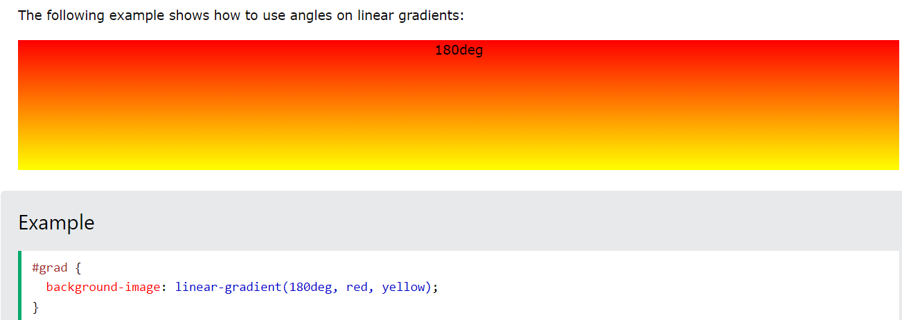

Slide 100
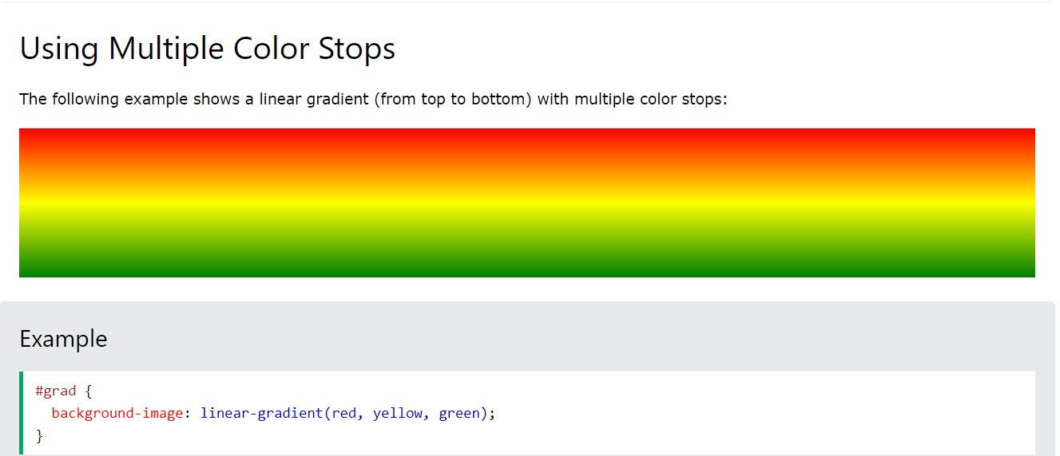

Slide 101
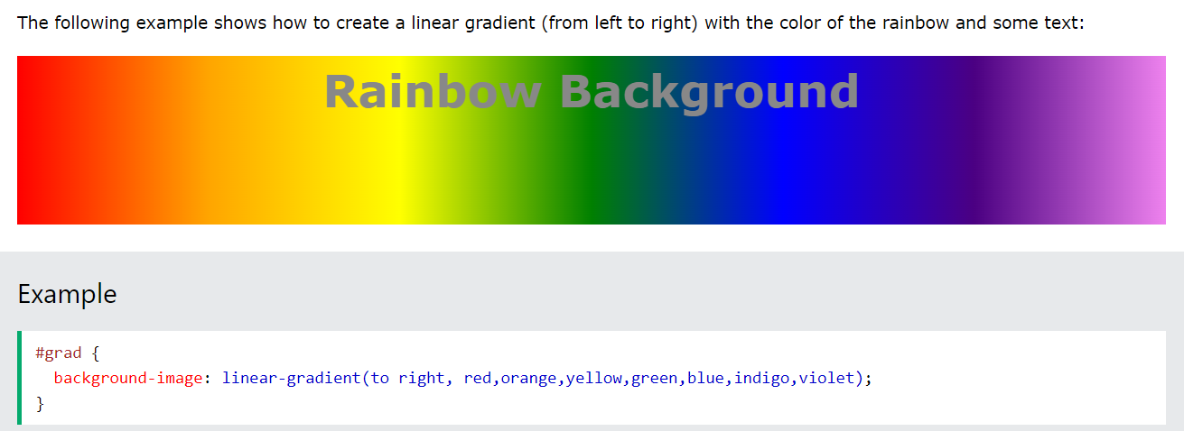

Slide 102
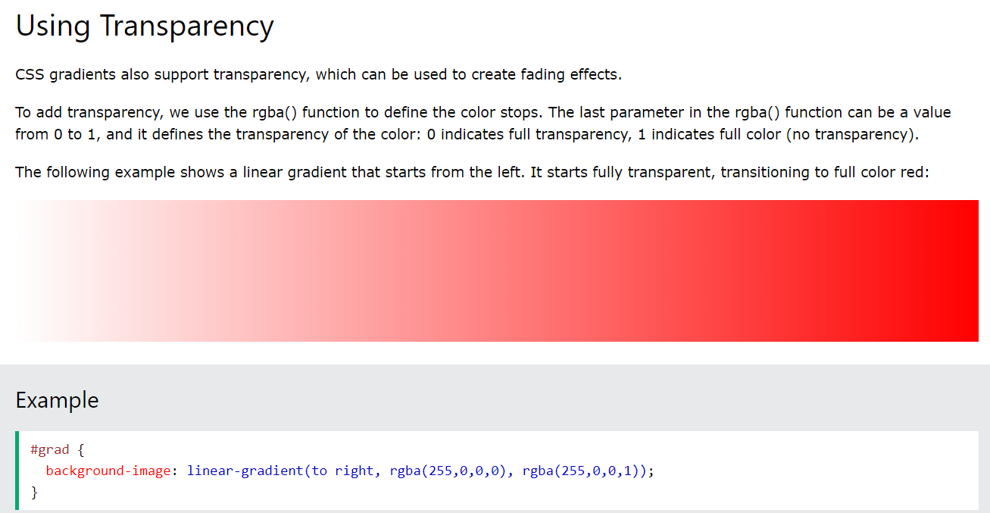

Slide 103
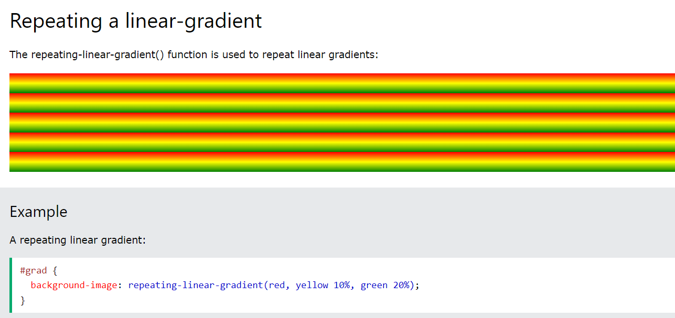

Slide 104
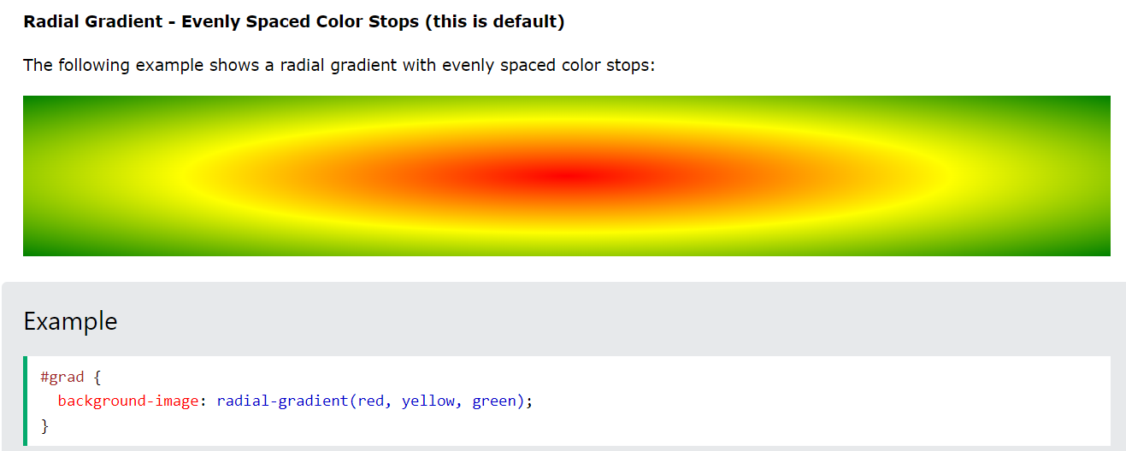
CSS Radial Gradients

Slide 105
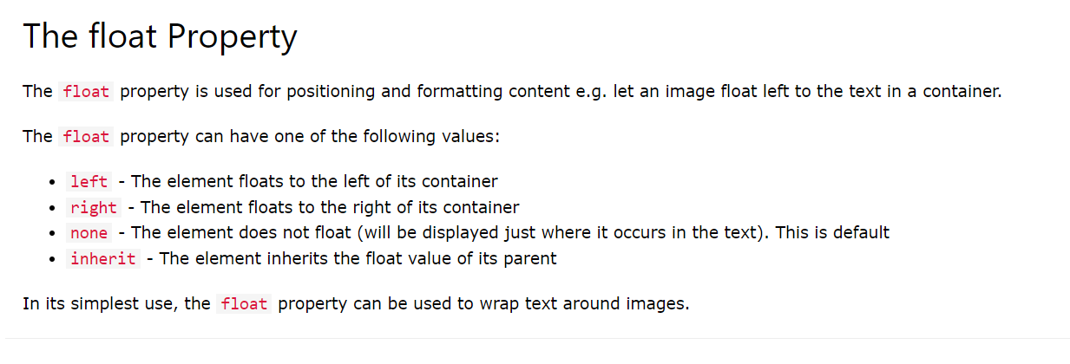
Float and Clear
property specifies how an element should float.

Slide 106
example
img {
float: right;
}
Example - float: left;
img {
float: left;
}

Slide 107
Float Next To Each Other
Example - No float
img {
float: none;
}

Slide 108
div {
float: left;
padding: 15px;
}
.div1 {
background: red;
}
.div2 {
background: yellow;
}
.div3 {
background: green;
}

Slide 109
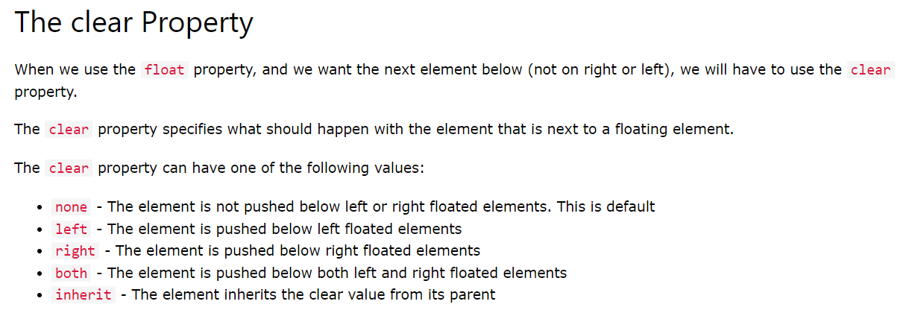
CSS Layout - clear and clearfix

Slide 110
div1 {
float: left;
}
div2 {
clear: left;
}

Slide 111
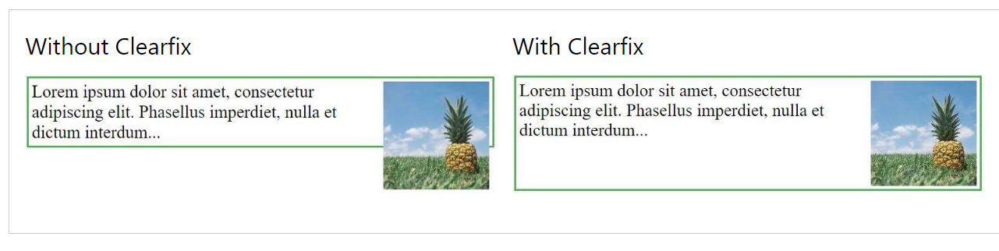
The clearfix Hack

Slide 112
example
.clearfix {
overflow: auto;
}
.clearfix::after {
content: "";
clear: both;
display: table;
}

Slide 113
New tags for the Layout
CSS Flexbox Layout
Use of flexbox ensures that elements behave predictably when the page layout must accommodate different screen sizes and different display devices.

Slide 114
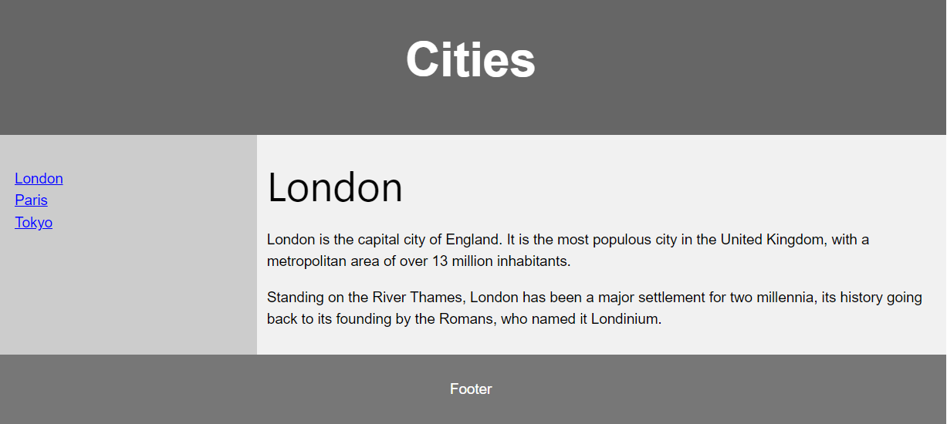

Slide 115
CSS Grid Layout
The CSS Grid Layout Module offers a grid-based layout system, with rows and columns, making it easier to design web pages without having to use floats and positioning.

Slide 116
Website layout
A website is often divided into headers, menus, content and a footer:

Slide 117
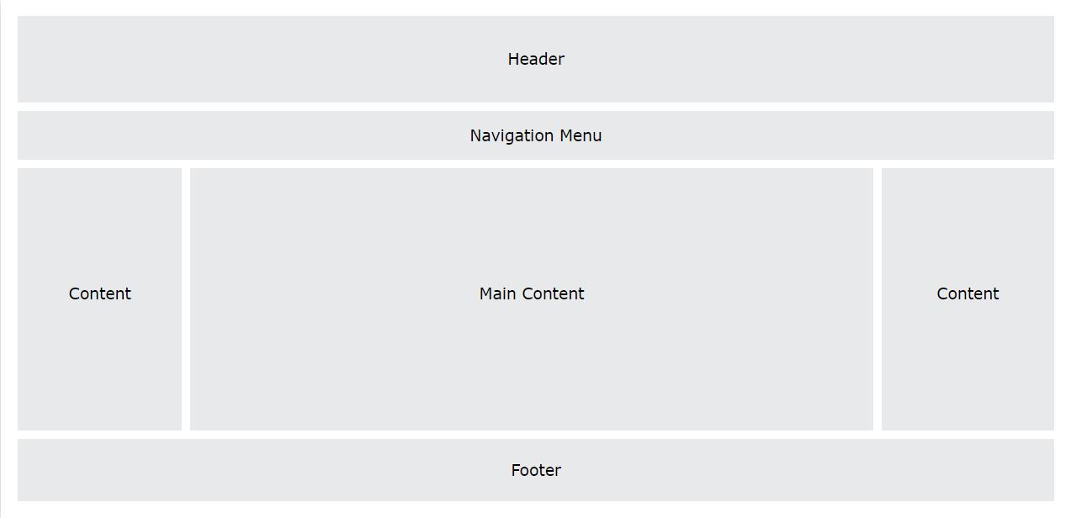

Slide 118
Header
A header is usually located at the top of the website (or right below a top navigation menu). It often contains a logo or the website name:
.header {
background-color: #F1F1F1;
text-align: center;
padding: 20px;
}

Slide 119
Navigation Bar
/* The navbar container */
.topnav {
overflow: hidden;
background-color: #333;
}
/* Navbar links */
.topnav a {
float: left;
display: block;
color: #f2f2f2;
text-align: center;
padding: 14px 16px;
text-decoration: none;
}
/* Links - change color on hover */
.topnav a:hover {
background-color: #ddd;
color: black;
}

Slide 120
Content
The layout in this section, often depends on the target users. The most common layout is one (or combining them) of the following:
1-column (often used for mobile browsers)
2-column (often used for tablets and laptops)
3-column layout (only used for desktops)

Slide 121
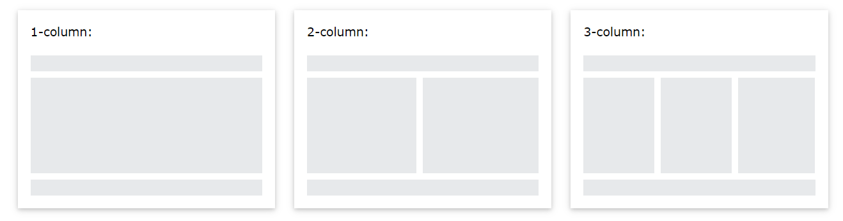

Slide 122
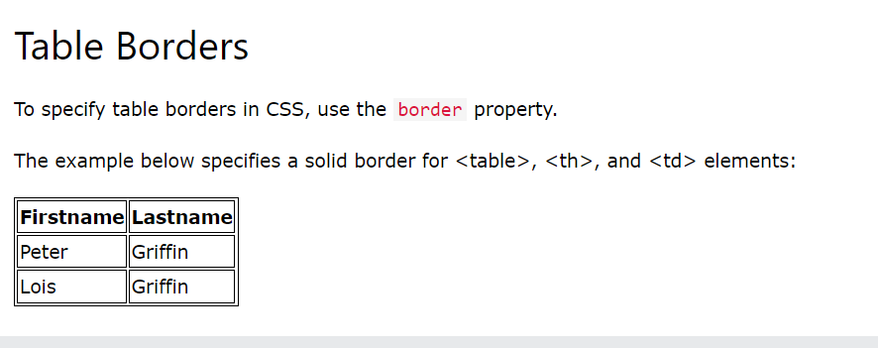
Styling Tables

Slide 123
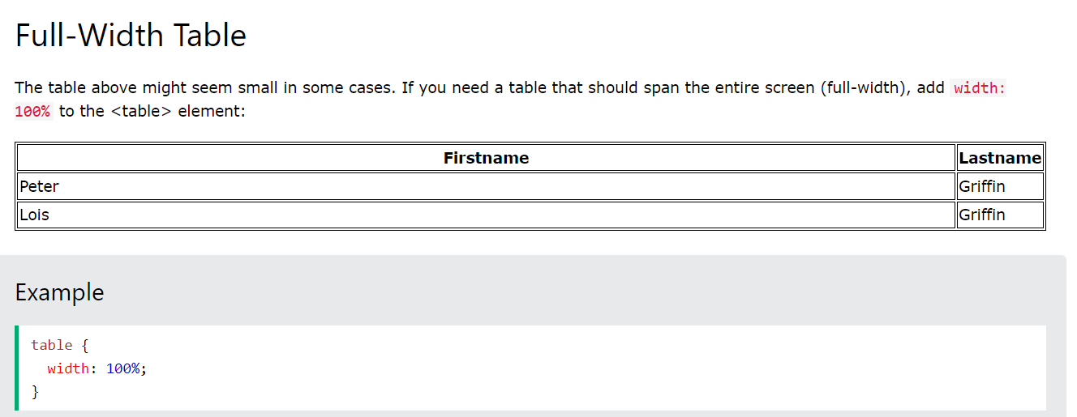

Slide 124
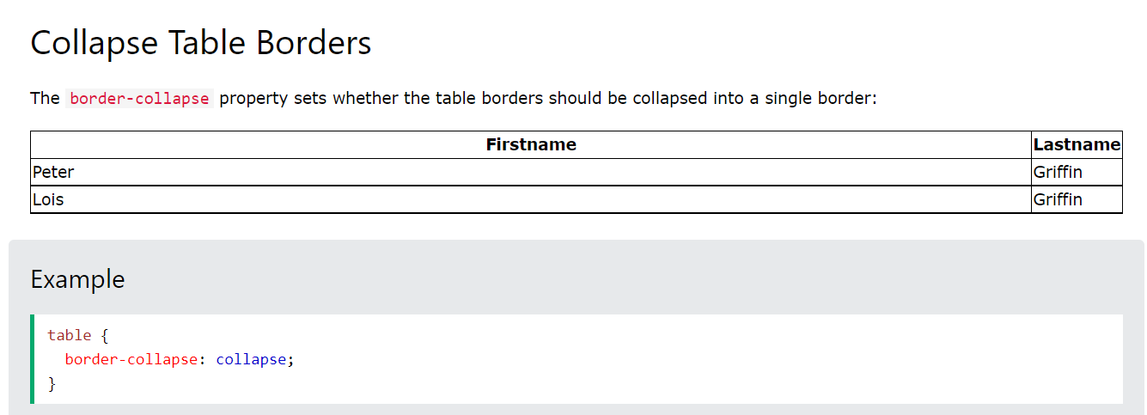

Slide 125
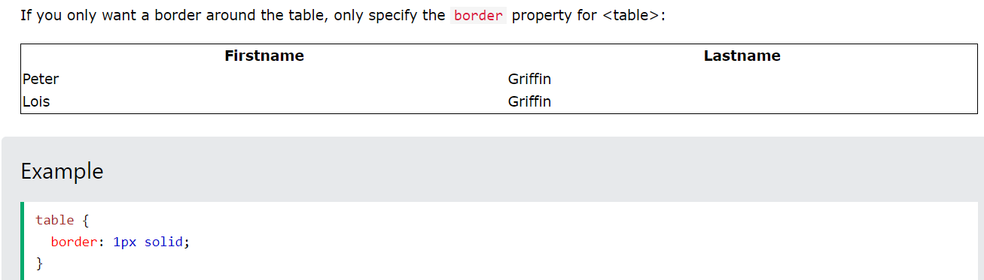

Slide 126
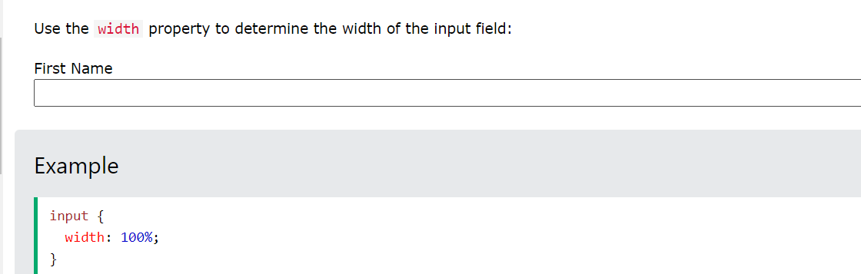
Styling fomrs
Styling Input Fields

Slide 127
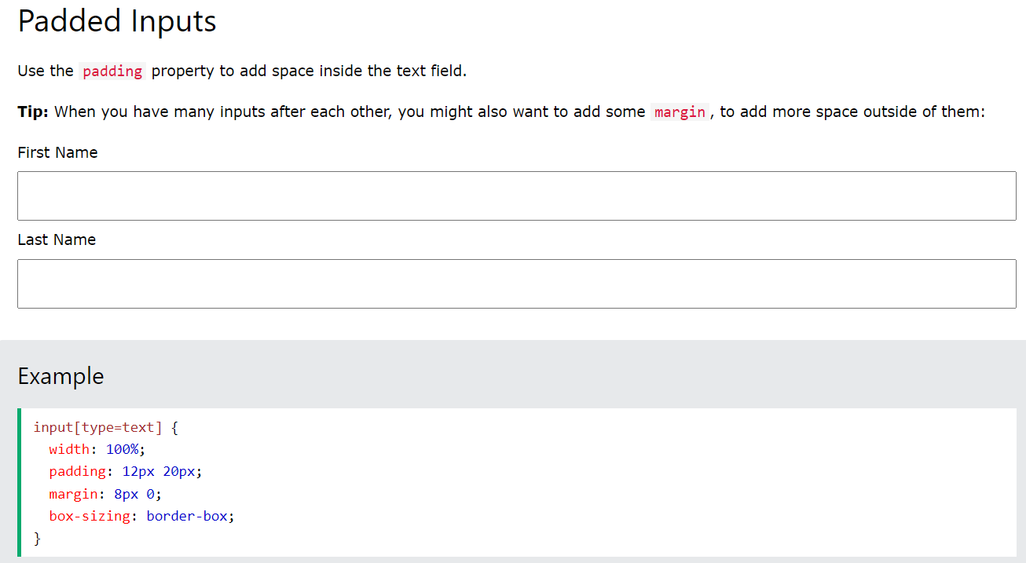

Slide 128
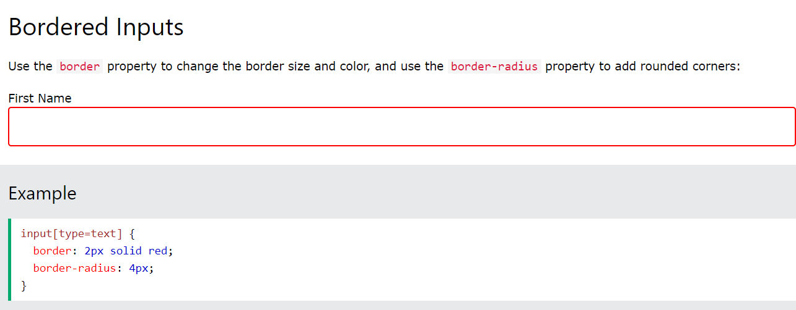

Slide 129
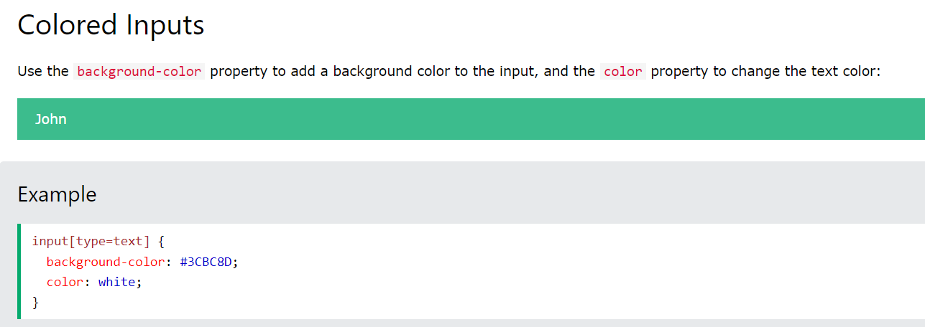

Slide 130
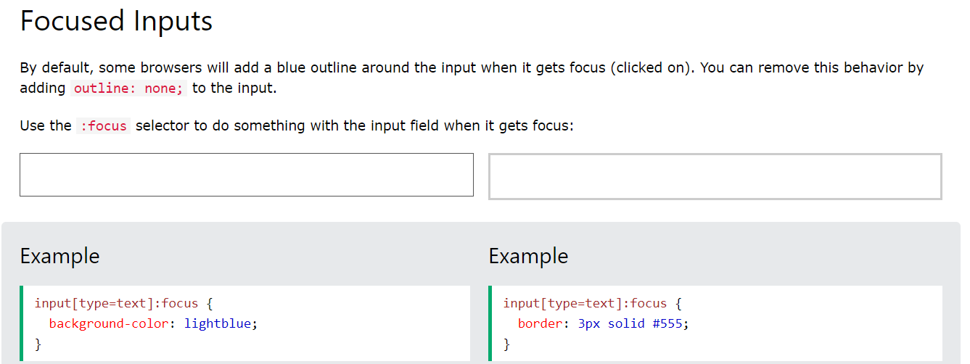

Slide 131
